Slide 1
Time Efficiency Comparison of High-Speed Rail vs. Airplane
Group J
Speaker: Zhi-Xun Xu
Notes:
Hello I am Zhi-Xun Xu, from group J.
The topic I am talking about today is time efficiency comparison of high speed rail and airplane.

Slide 2
Introduction
The speed of an airplane is much faster than that of high-speed rail.
900 km/hr vs 300 km/hr
When considering the total time cost, which option is truly faster?
Access time to airports and stations
Processing time in airports and stations
In-vehicle travel time
Return time to downtown
Notes:
Apparently, airplanes are much faster than high-speed rail.
However, there are several issues needed to be considered when it comes to the total time cost.
First, it’s the access time. Typically, stations are located downtown. But, airports often require more time to access.
Second, it’s the processing time.
For high-speed rail, it's easy: pick up your ticket, pass through the gate, walk to the platform, and wait for your train and then board
For airplanes, it’s more complicated: check in and drop off your bag if needed, pass through security screening, walk to the gate, and wait for boarding.
Third is the in vehicle travel time. Airplanes are faster than high speed rail.
The last one is the return time which means the time passengers needed to return to downtown.
It’s hard to say which mode is faster.

Slide 3
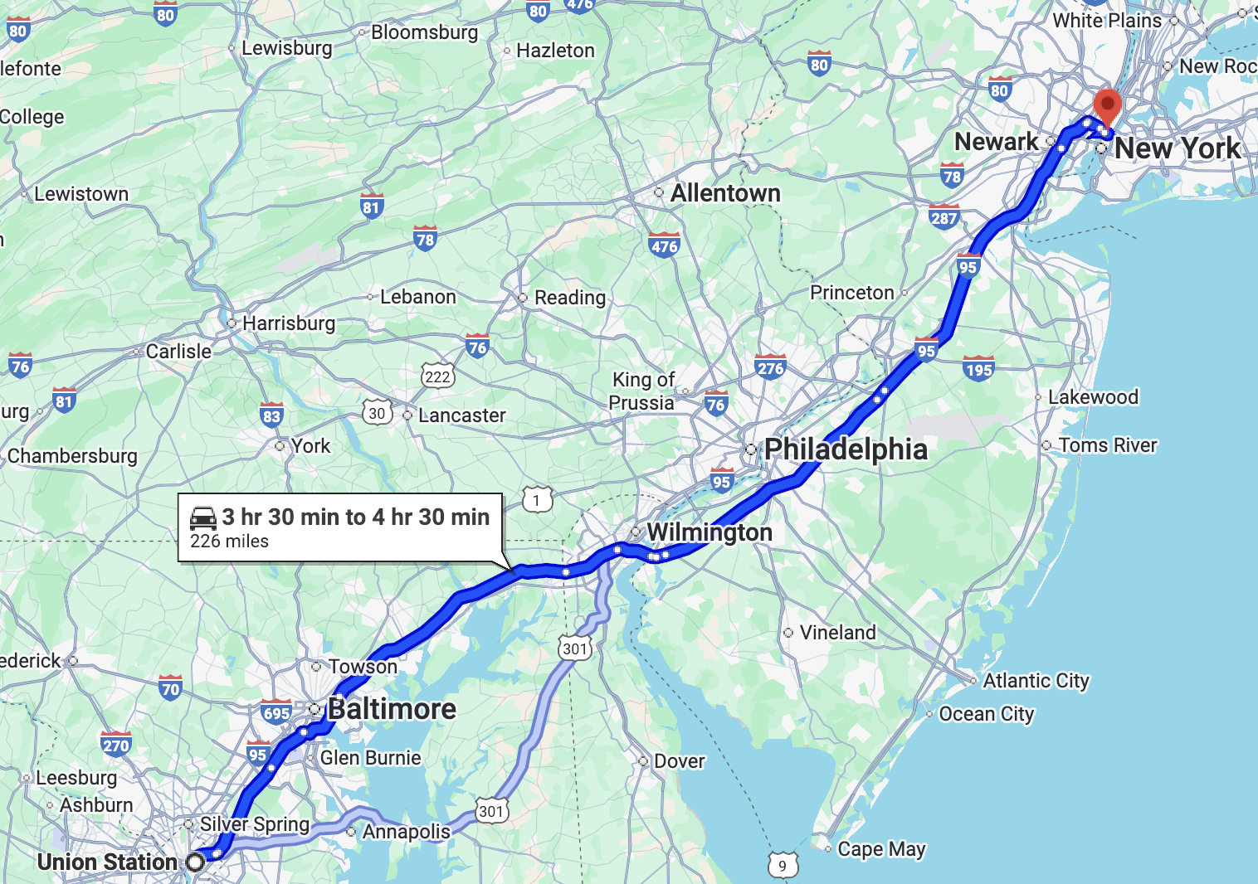
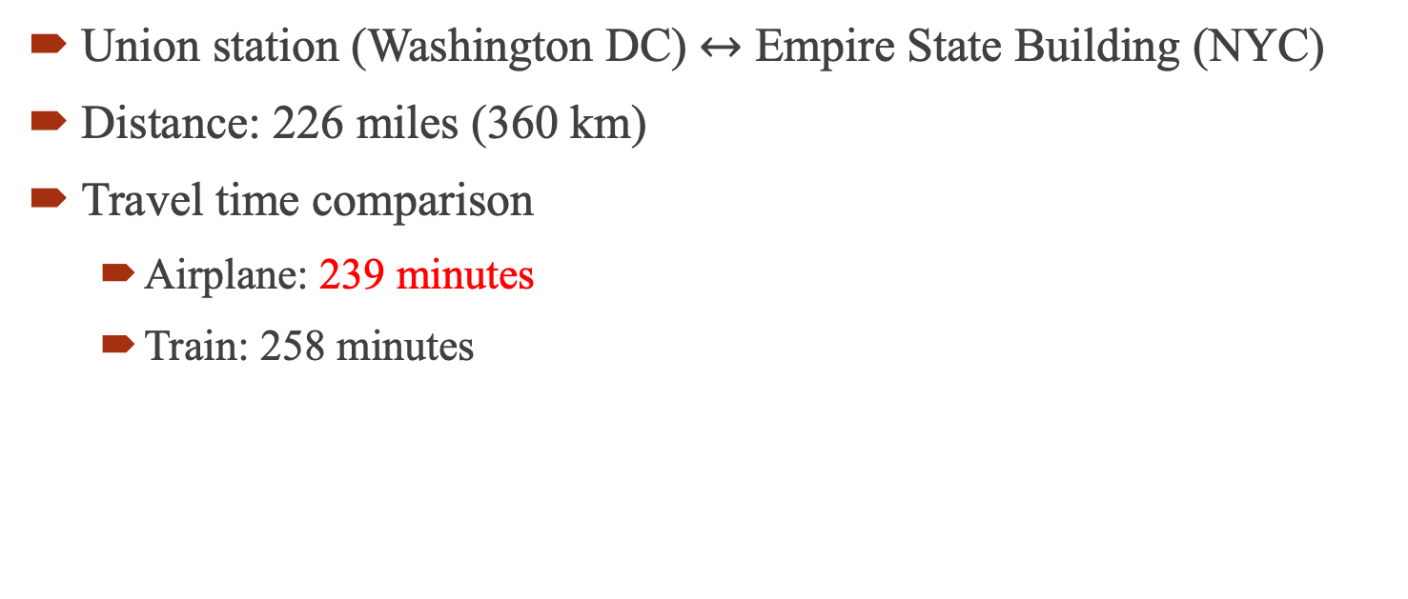
Introduction
Union station (Washington DC) $↔$ Empire State Building (NYC)
Distance: 226 miles (360 km)
Travel time comparison
Airplane: 239 minutes
Train: 258 minutes
Source:https://www.youtube.com/watch?v=Hwd3QHx1DVc&t=650s
Notes:
To give you some flavor, let’s see some testing example.
The first one is from Union station, Washington DC, to Empire state building.
The distance is about 360 km.
For airplane, the total time cost is 239 minutes. For train, the total time is 258 minutes.
In this case, airplane is faster.

Slide 4
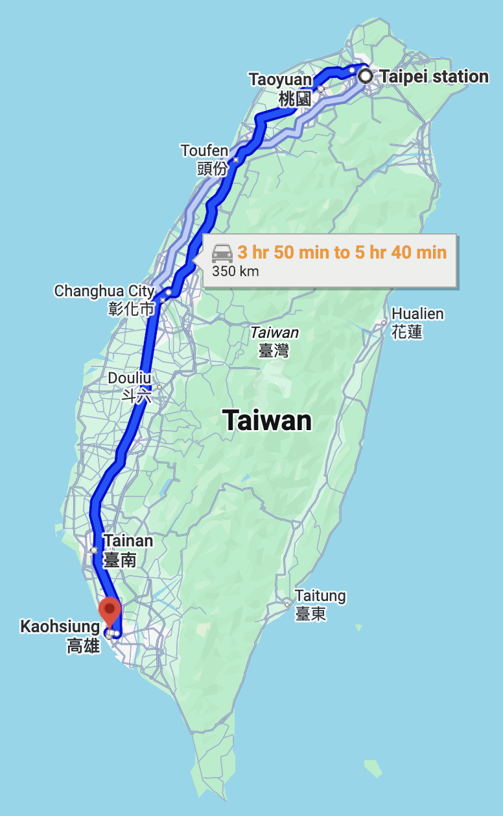

Introduction
Taiwan: Taipei $↔$ Kaohsiung
Distance: 218 miles (350 km)
Travel time comparison
Airplane: 160 minutes
Train: 130 minutes
Source:https://hdl.handle.net/11296/f798fh
Notes:
There is another case with similar distance.
It’s from Taipei to Kaohsiung, two cities in Taiwan.
The total time cost for airplane is 160 minutes.
The cost for trains is 130 minutes.
So in this case, train is faster.

Slide 5
Introduction
High-speed rail’s competitive range: 200 – 1000 km
Accessibility of airports and stations
Train operating characteristics
Train speed
Train stop frequency
Airport passenger processing
Security screening
Baggage drop-off and claim
Delay and reliability
Source1: https://doi.org/10.1155/2017/8426926
Source2: https://doi.org/10.1080/01441640600589319
Notes:
So, sometimes, airplane is faster but sometimes, train is faster.
According to these research papers, the competitive range of high-speed rail is between 200 and 1,000 km.
Possible factors include
Because there are so many uncertainties, I am using Monte Carlo simulation to approach this question.

Slide 6
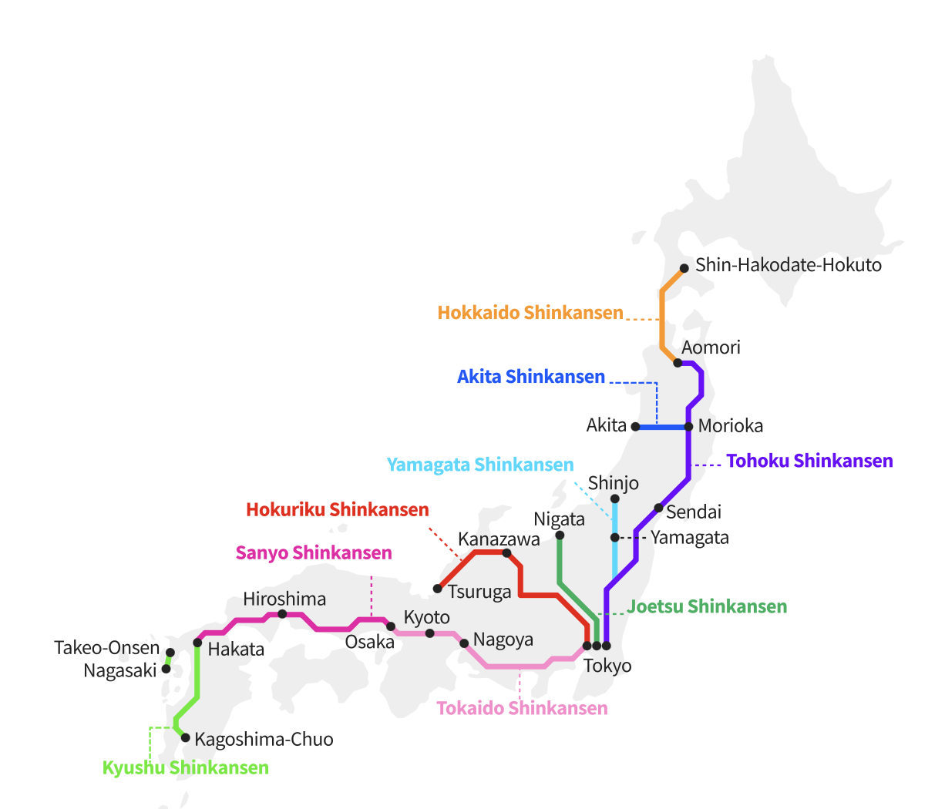

Case Study (Shinkansen)
Tokyo $↔$ Hakata
Nagoya (366 km)
Osaka (552.6 km)
Okayama (732.9 km)
Hiroshima (894.2 km)
Hakata (1174.9 km)
Operating speed: 300 km/hr
Source:https://www.jrailpass.com/shinkansen-bullet-trains
Notes:
To do that, we need a high-speed rail line whose operating distance is about 1,000 km. There is one in Japan, from Tokyo to Hakata. Ｗe can use this line to see how the competitive range of high-speed rail changes.

Slide 7
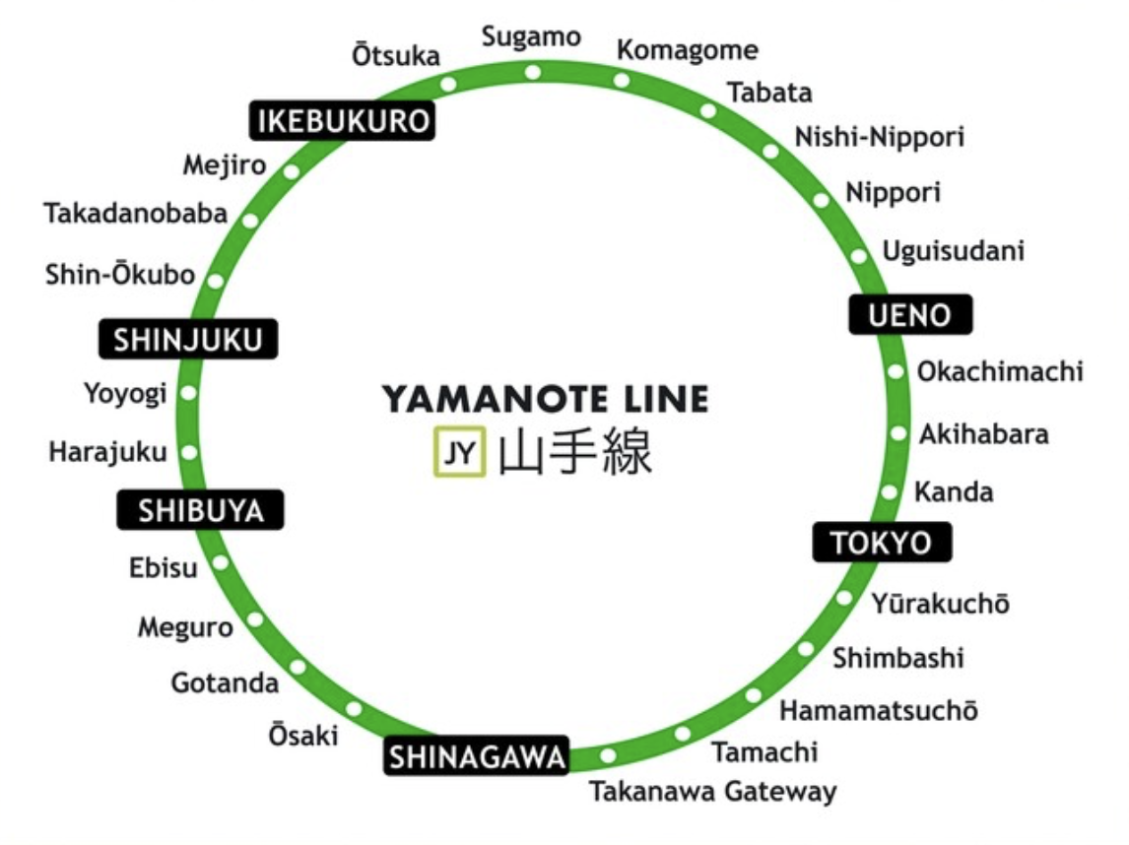
Case Study (Access Time)
Travel demand is randomly generated at the stations along the Yamanote Line.
High speed rail access time (Tokyo station)
Yamanote Line
Airport access time (Haneda airport)
Yamanote Line
Transfer waiting time (1 ~ 4 minutes)
Monorail (25 minutes)
Source:https://japanalytic.com/2021/01/29/yamanote-line-map-info/
Notes:
So first, lets talk about the access time to high speed rail stations and airports.
Travel demand is randomly generated within Tokyo along the Yamanote Line, which is a circular railway line in Tokyo.
The high-speed rail departs from Tokyo Station. The nearest airport is Haneda Airport, and passengers must transfer at Hamamatsuchō Station to take the monorail to the airport. The transfer waiting time ranges from 1 to 4 minutes, and the monorail’s in-vehicle travel time is 25 minutes.

Slide 8
Case Study (Processing Time)
High speed rail (20 ~ 30 minutes)
Ticket check / Gate entry
Walking to the platform
Platform waiting time and boarding
Flight (60 ~ 90 minutes)
Baggage drop-off / Check in
Security screening
Walking to the gate
Gate waiting time and boarding
Notes:
After arriving at airports and stations, passengers have to go through several procedures.
The time needed is called processing time.
For high speed rail, it’s 20~30 minutes, including
For flights, it’s 60 ~ 90 minutes, including

Slide 9
Case Study (In-Vehicle Travel Time)
 | Mileage (km) | High Speed Rail (mins) | Flight (mins)
Nagoya | 366 | 97 | 60
Osaka | 552.6 | 150 | 70
Okayama | 732.9 | 190 | 80
Hiroshima | 894.2 | 230 | 90
Hakata | 1174.9 | 300 | 130
Notes:
The in-vehicle travel time can be obtained from the timetables provided by rail and airline companies.

Slide 10
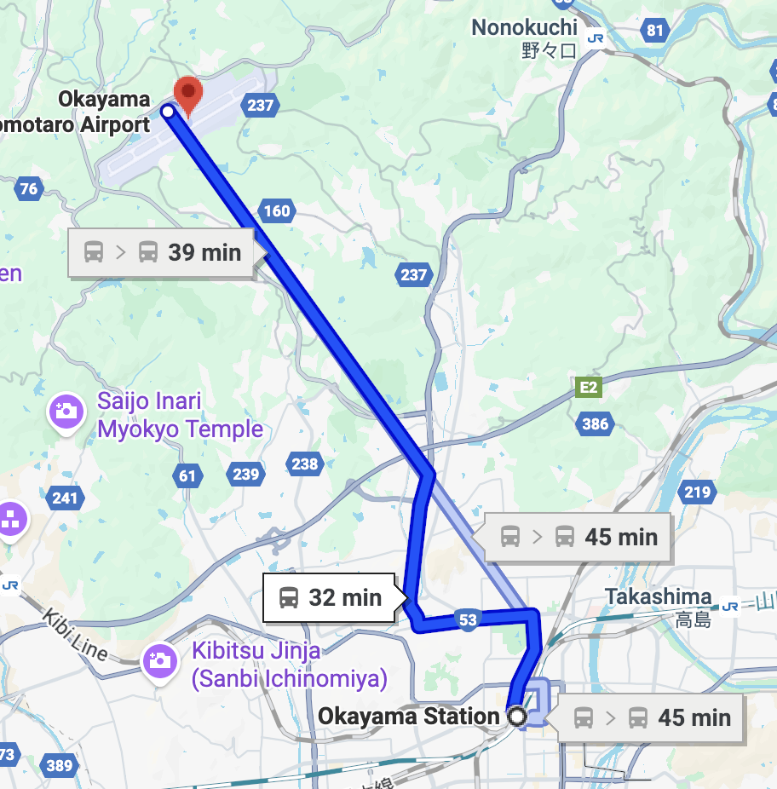
Case Study (Return Time)
High speed rail (0 minute)
Flight (40 ~ 60 minutes)
Get off the plane
Claim baggage
Return to downtown
Source:https://japanalytic.com/2021/01/29/yamanote-line-map-info/
Notes:
The last one is the return time. Here, I assume that the high-speed rail station is located in downtown. The time range is 40 – 60 minutes.
For passengers taking flights, they need additional time to travel back to downtown.
Currently, all samplings are from uniform distributions.

Slide 11
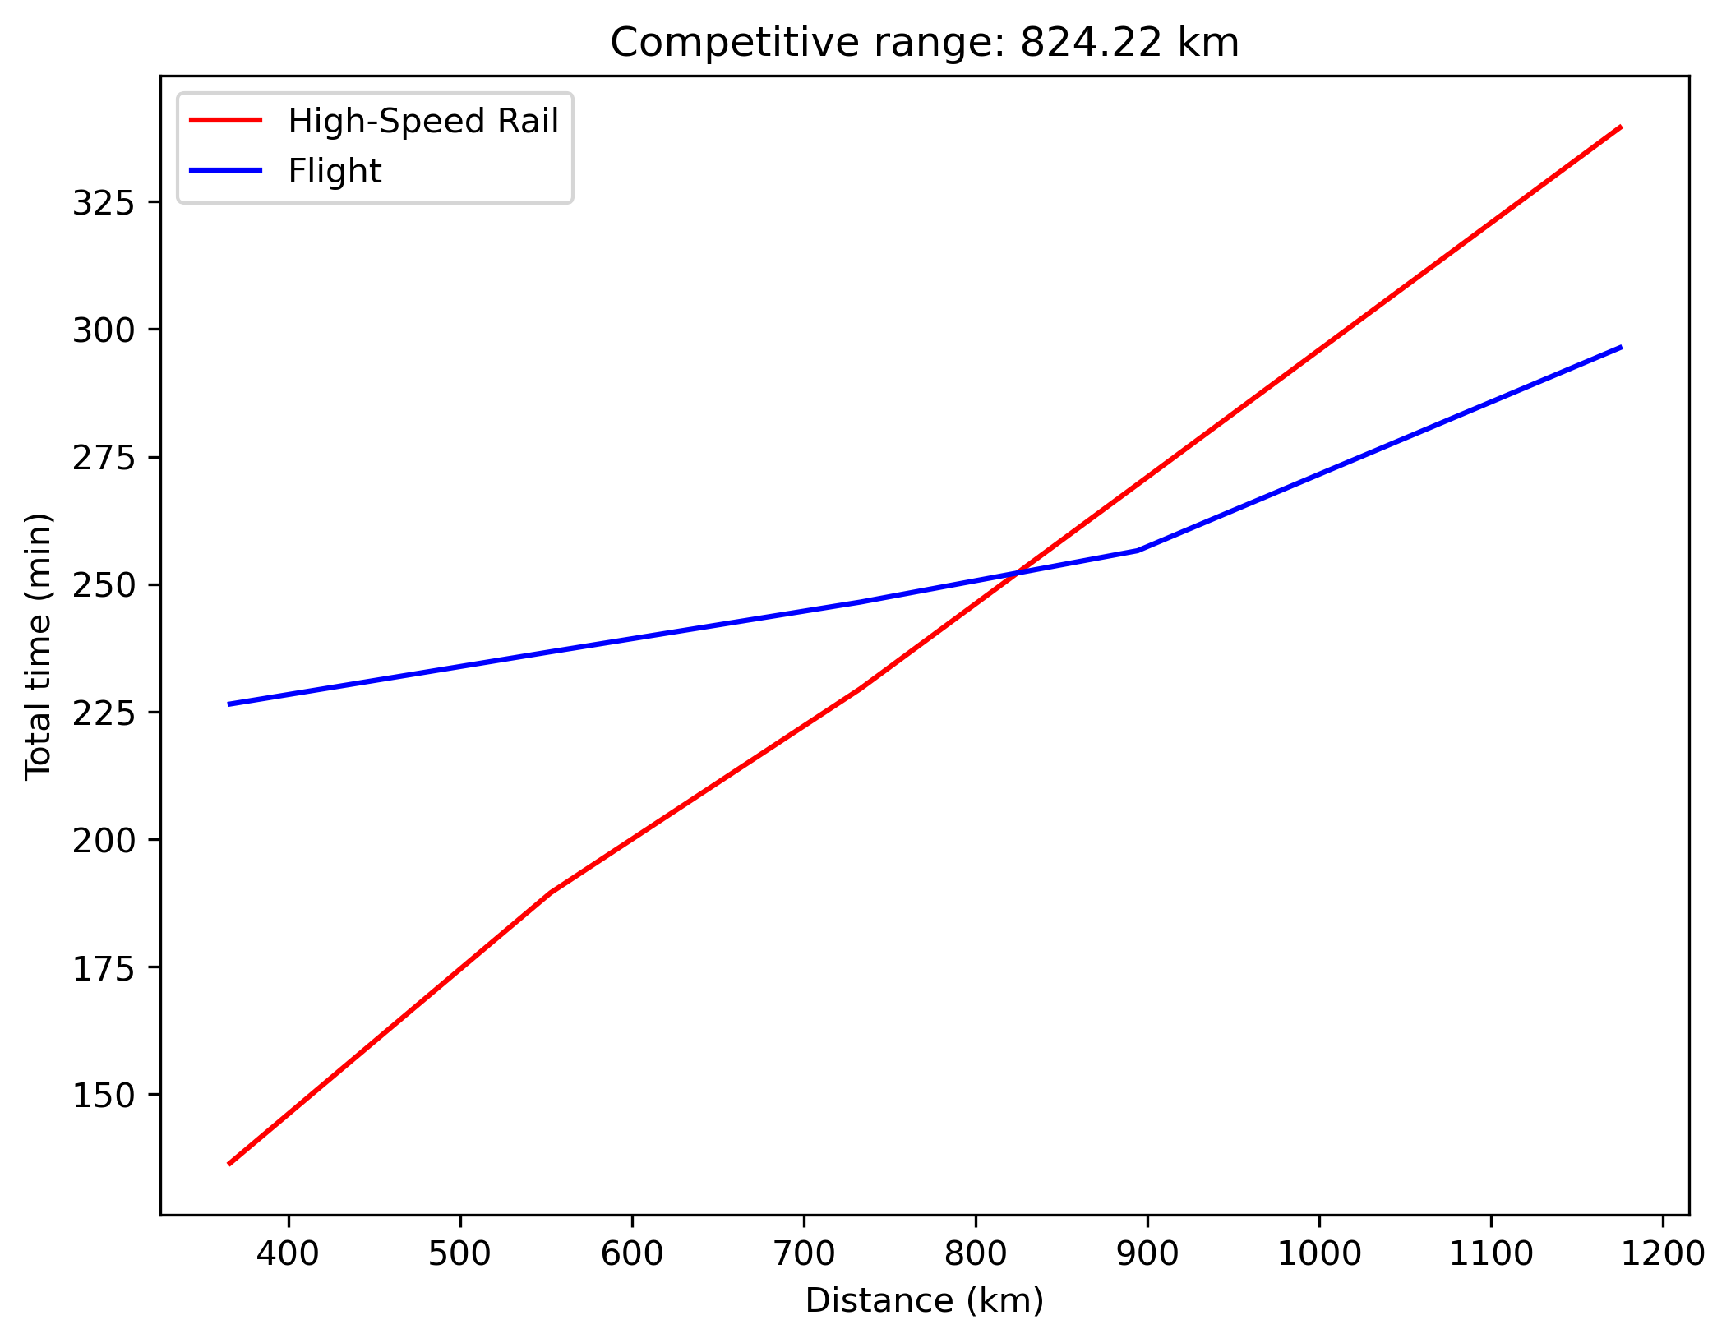

Case Study (Total Time)
$T_{tol}=T_{access}+T_{processing}+T_{travel}+T_{return}$
Competitive range: 824 km
Notes:
Finally, I calculate total time costs and take the average over all samples.
As you can see, in this figure, there is a crossing point at 824 km.
This means that, with the current high-speed rail system, the competitive range for high speed rail is about 824 km. So if your destination is within roughly 800 km, you would prefer to take high-speed rail.

Slide 12
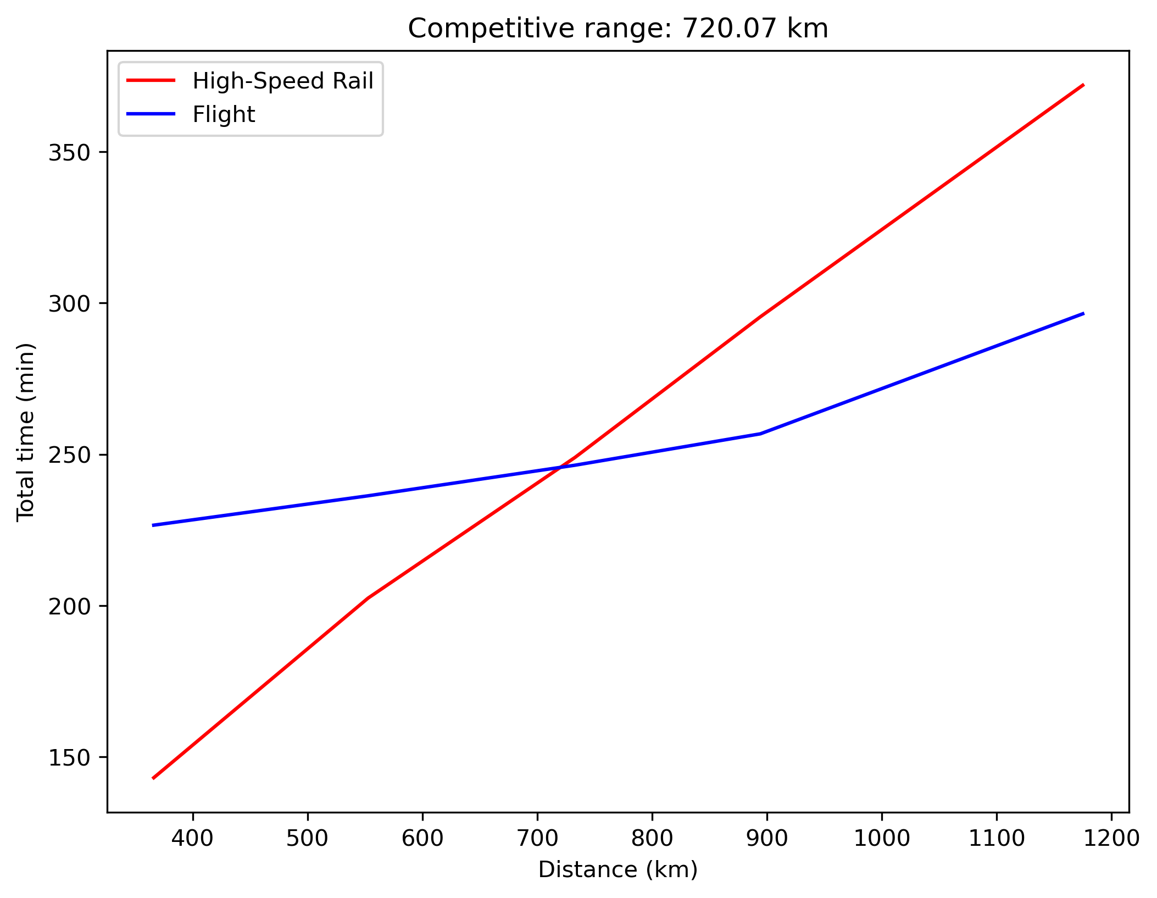

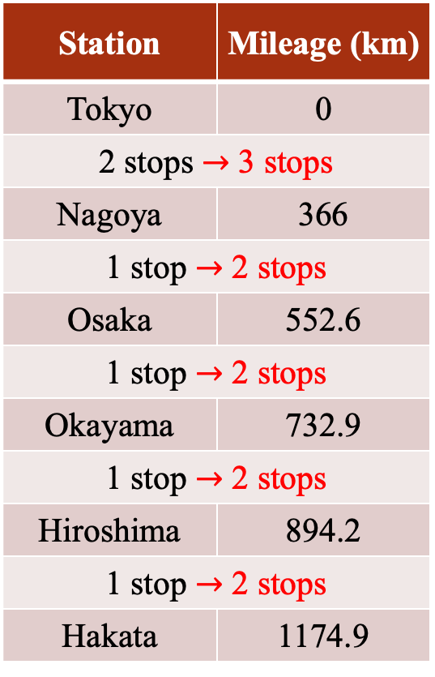
Discussion
Station | Mileage (km)
Tokyo | 0
2 stops $→$ 3 stops
Nagoya | 366
1 stop $→$ 2 stops
Osaka | 552.6
1 stop $→$ 2 stops
Okayama | 732.9
1 stop $→$ 2 stops
Hiroshima | 894.2
1 stop $→$ 2 stops
Hakata | 1174.9
Stop frequency of train
6.5 minutes of time loss per stop
Add an additional stop in each segment
Competitive range: 824 km $→$ 720 km
Source:https://infrastructure.aecom.com/transportation/how-fast-is-too-fast-for-high-speed-rail?utm_source=chatgpt.com
Notes:
And then, let’s talk about stop frequency of train.
According to this reference, the time loss for each stop is 6.5 minutes for high speed rail.
If rail company adds just one additional stop in each segment, the competitive range decreases significantly—from 824 km to 720 km.
This means the company can attract passengers traveling to the new stops, but it will lose passengers whose destinations are between 720 and 824 km. So, there is a trade-off.

Slide 13
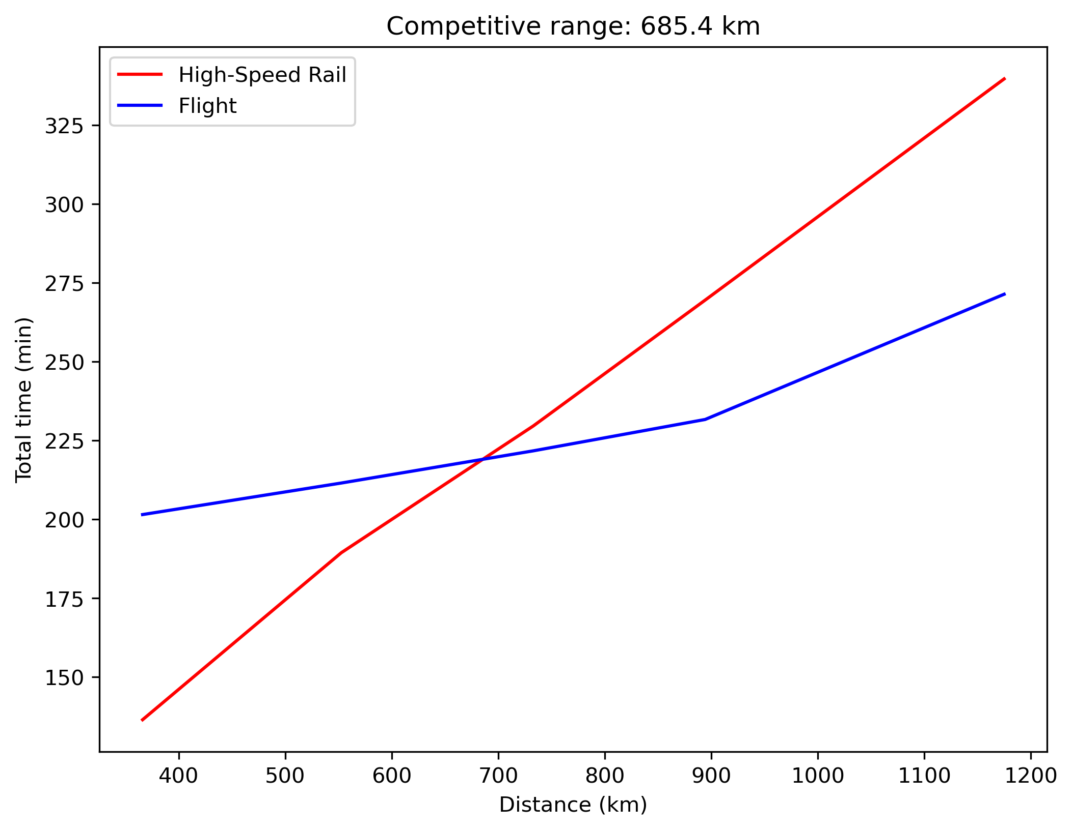
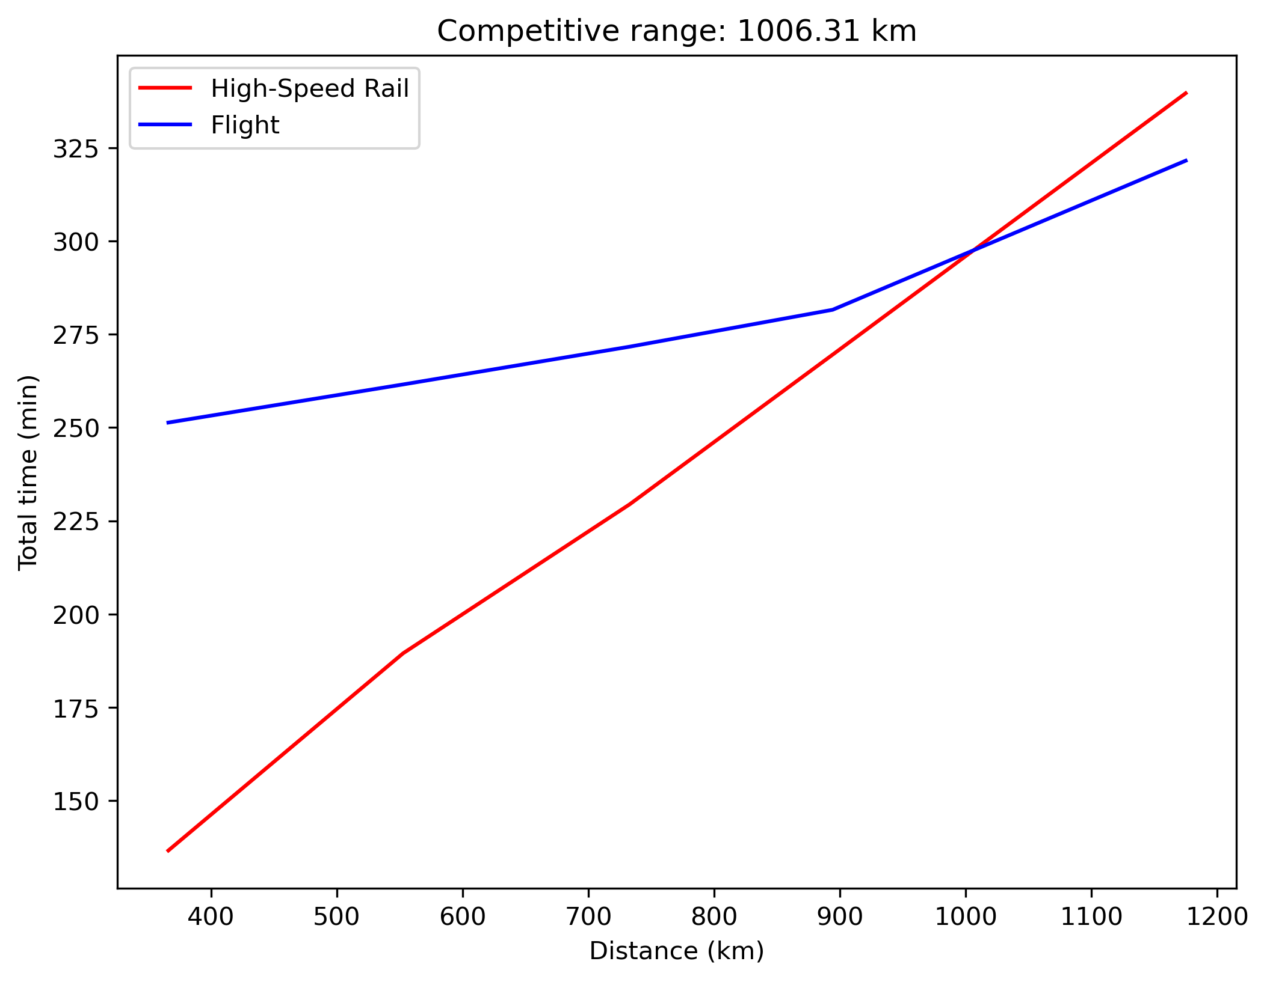
Discussion
Changes in flight processing time (current: 60 ~ 90 minutes, 824 km)
Off-peak periods: 40 ~ 60 minutes (685 km)
Holidays: 80 ~ 120 minutes (1006 km)
Notes:
Now, let’s talk about flight processing time. In my initial setting, the processing time is 60–90 minutes, but this can vary.
During off-peak periods, for example, it may drop to 40–60 minutes. In this case, the competitive range decreases to 685 km because taking a flight becomes more convenient.
However, during holidays, it can be a nightmare. Processing may take 80–120 minutes just to be safe. In this scenario, the competitive range is over 1,000 km. People would choose high-speed rail because train processing time is much shorter than that of flights.

Slide 14
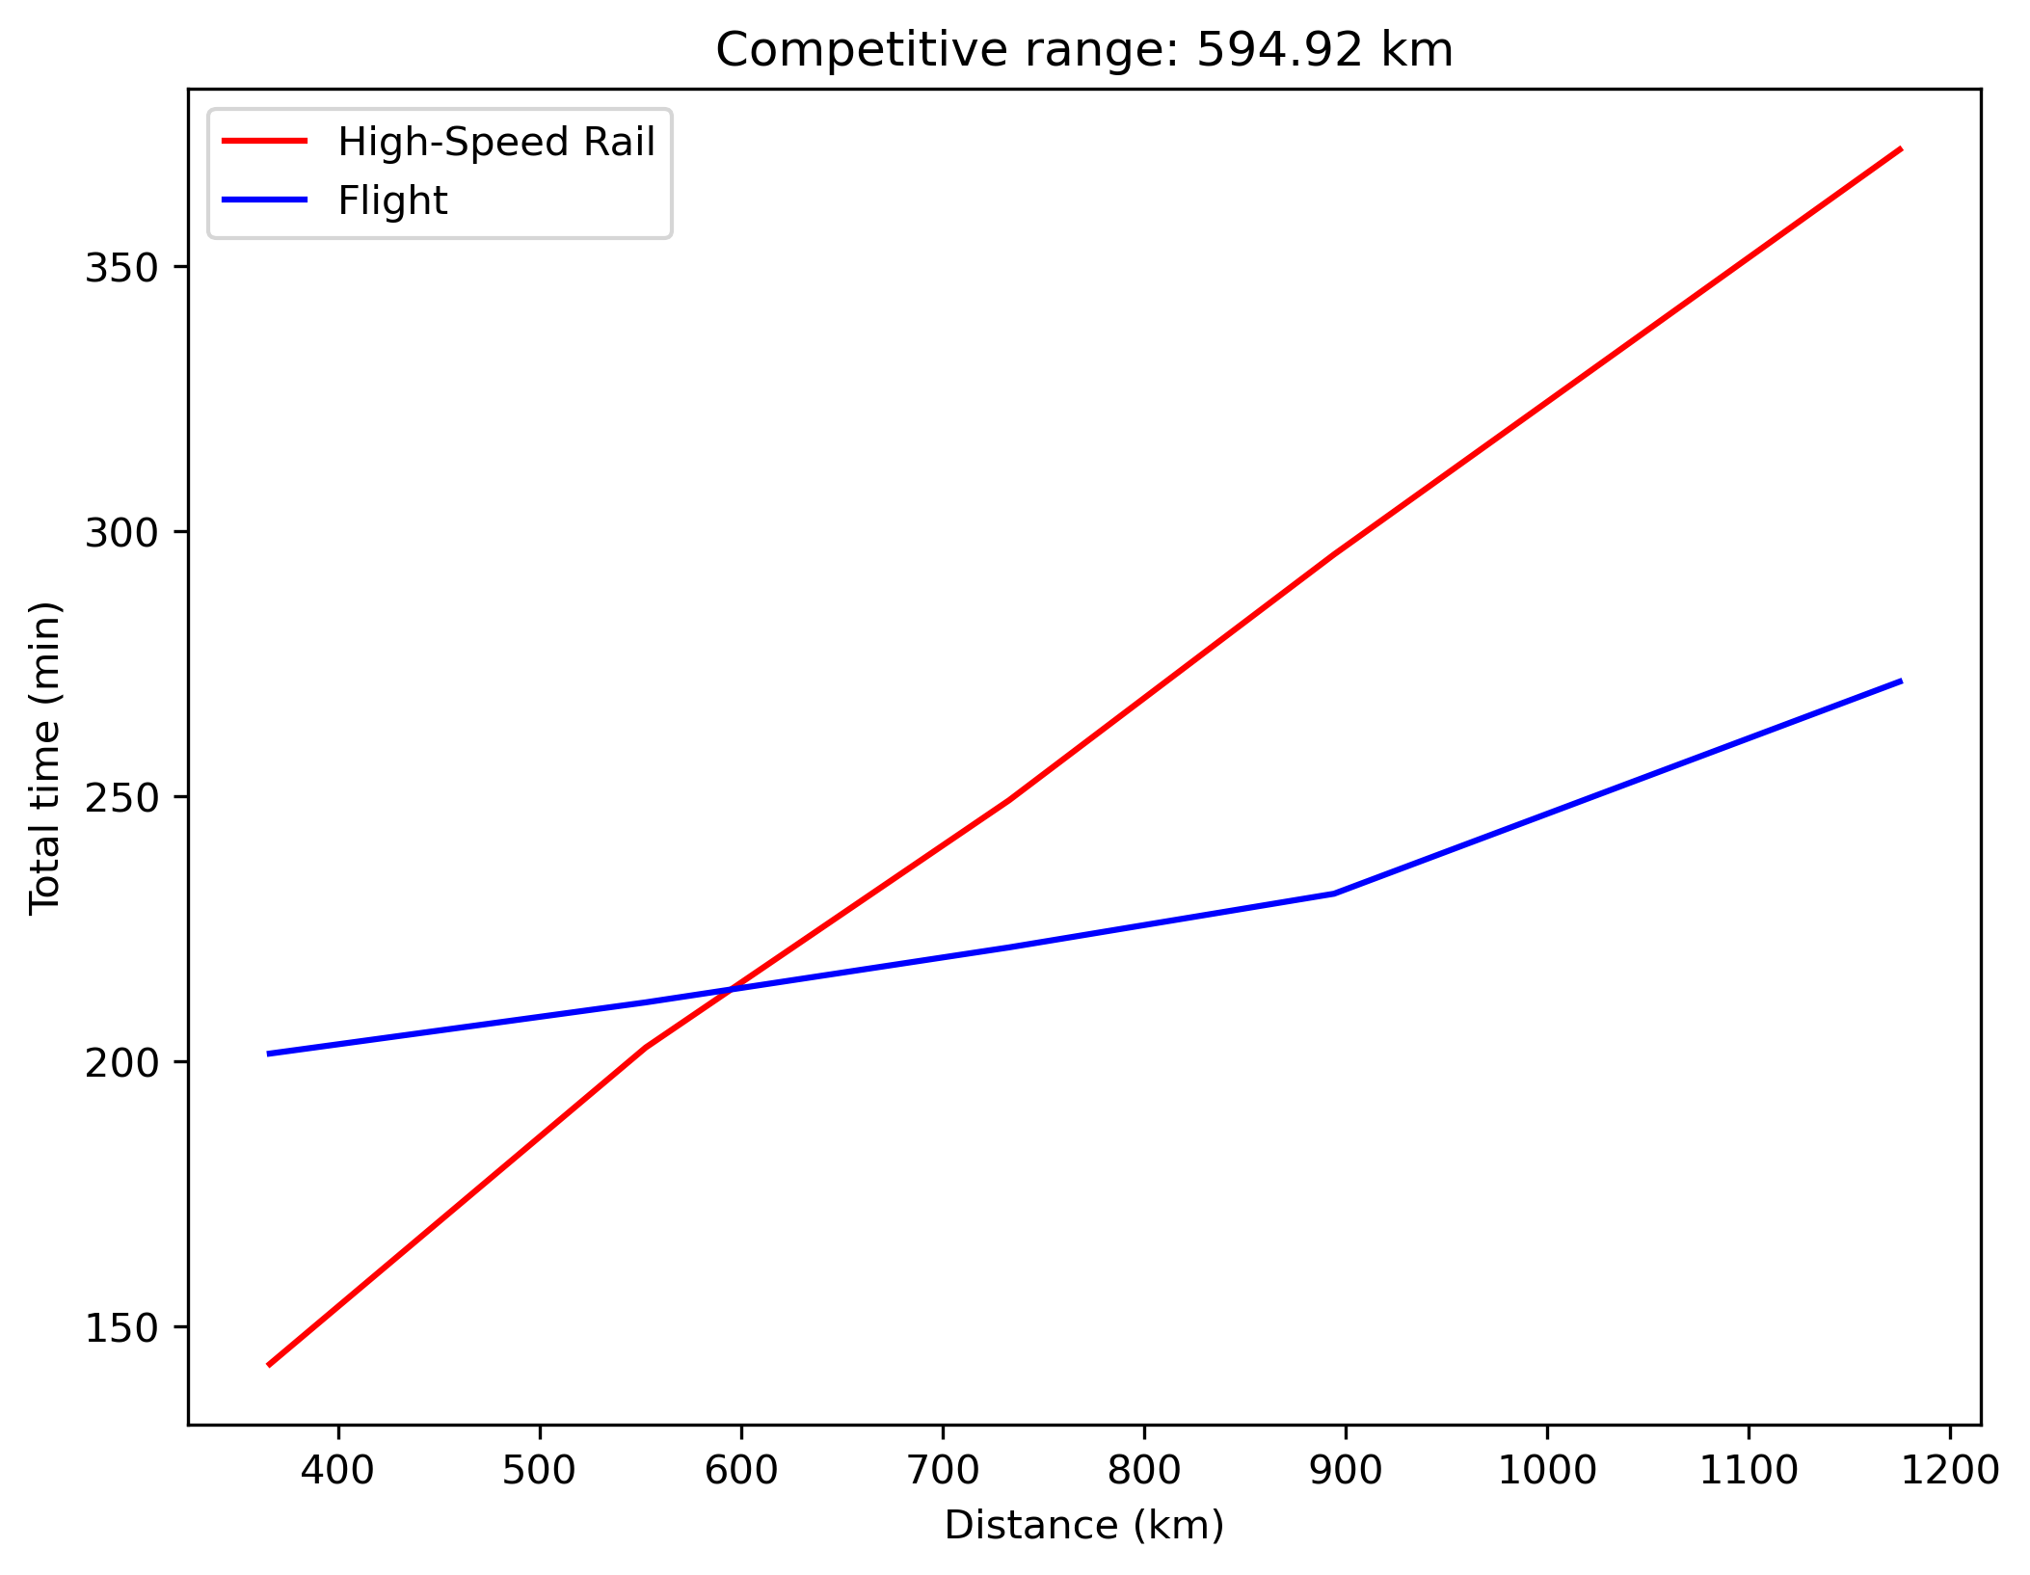

Discussion
Add an additional stop in each segment
Off-peak flight processing time (40 ~ 60 minutes)
Competitive range: 594.92 km > 552.6 km (Tokyo $↔$ Osaka)
Notes:
Now, lets consider this extreme case.
Add one additional stop and use off-pick flight processing time.
The competitive range is 594 km larger than the distance between Tokyo and Osaka.
This result explains why many videos on YouTube show that high-speed rail is always faster.

Slide 15
Future Directions
Advanced modeling options
Change access time and return time
Adjust train travel time (600 km/hr, maglev train)
Use a different random sampling distribution
Consider delays of trains and flights
Applications
Determine travel demand
Optimize operations for flight and train companies
Source:https://www.youtube.com/watch?v=tiufz6wS4dI
Notes:
For future directions, there are two categories.
First, we can change model options.

Slide 16
Thank you for listening.
Notes:
This is my presentation today.
Thank you for listening.

